Slide 1
Your family name
Family Network
Welcome Guide
COMMUNICATE ON A PRIVATE AND SECURE PORTAL

Slide 2
Welcome to the your family name Family Network
Dear Family,
The shareholder intranet is now live and will help us to communicate and exchange information on a private and secure portal.
The objective for our site is to share updates on the family, facilitate the management of our meetings and events, to create an archive of our information and to share updates from the business.
In a continuous effort to engage with the whole family, we have prepared a tutorial guide to the platform.
https://insertyourdomain.trustedfamily.net

Slide 3


Slide 4
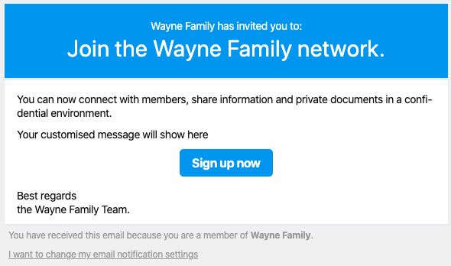
Registration Process
1. Invitation Email
You will receive an invitation email from the insert your network name Network. Select Sign up now to register your account.
https://insertyourdomain.trustedfamily.net

Slide 5
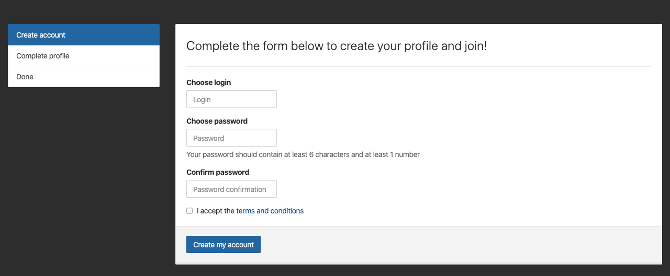
Registration Process
2. Create Your Profile
Complete your registration by choosing a password, followed by your basic contact details.
https://insertyourdomain.trustedfamily.net

Slide 6
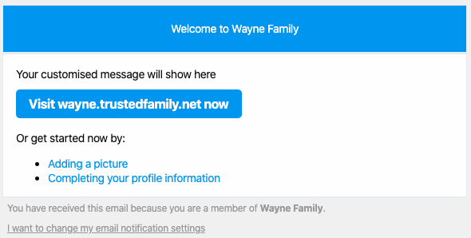
Registration Process
3. Welcome Email
Once you’re registered you will receive a confirmation email that will provide links to the next steps of completing your profile.
https://insertyourdomain.trustedfamily.net

Slide 7
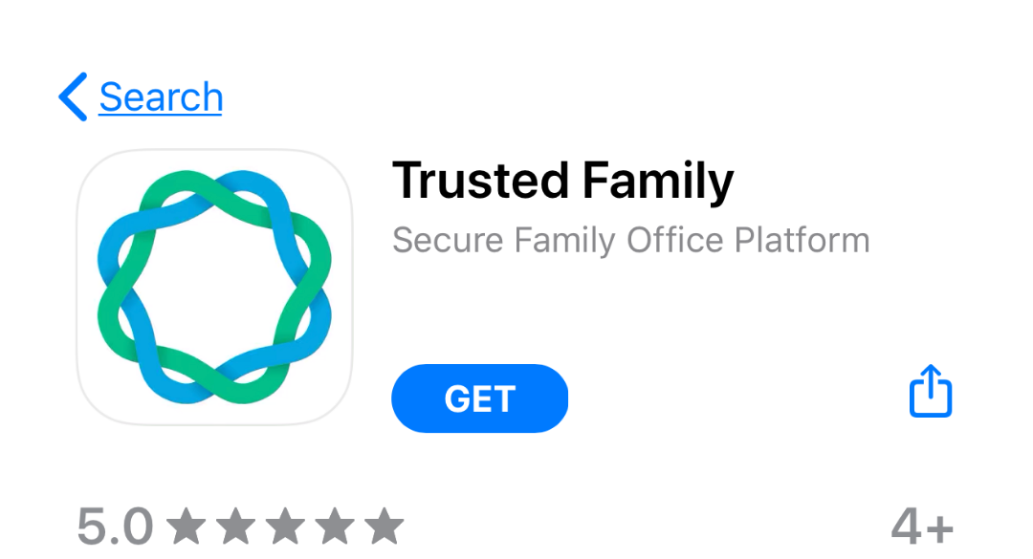
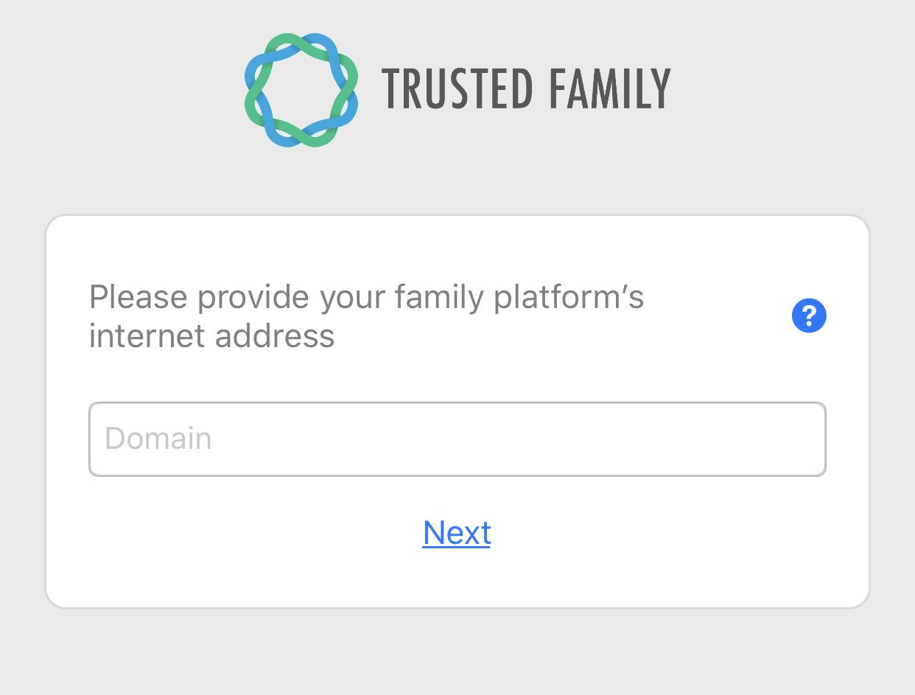
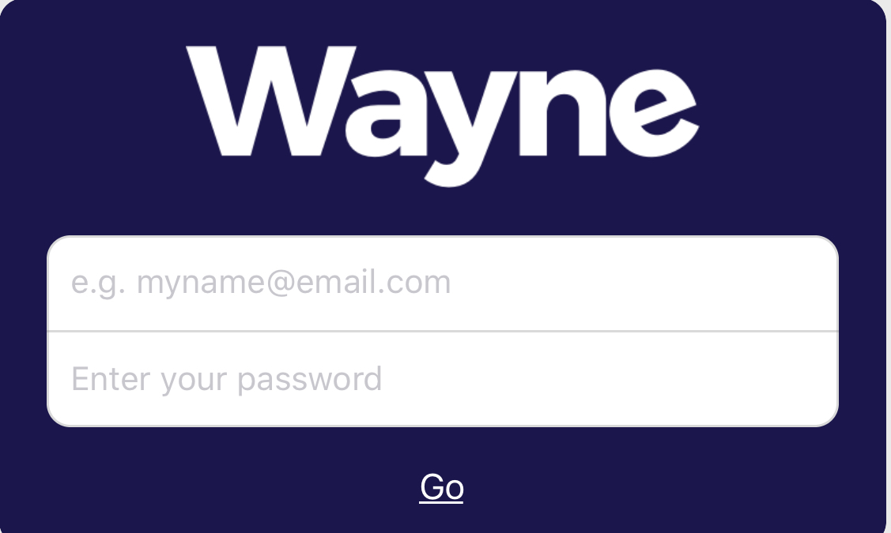
Download Trusted Family on your Phone
Get the App
Find your platform name
Log in
After you are registered, go to the App Store or Google Play and download the Trusted Family App your phone or ipad.
In the App, you will be asked to provide your family platform’s internet address. Simply enter insert your domain and hit Next.
Now you can use the email and password you selected when you registered to login.
https://insertyourdomain.trustedfamily.net

Slide 8
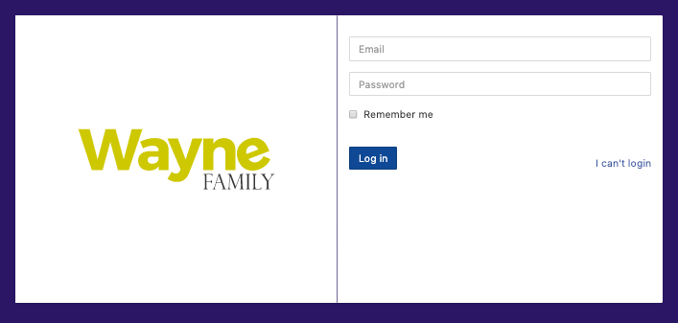
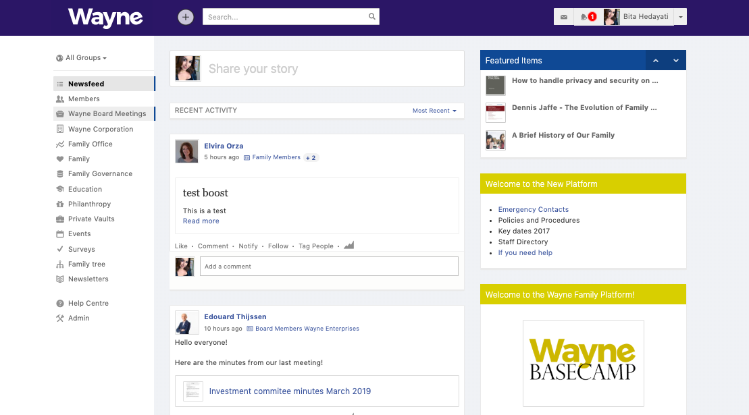
Find the Site on a Web Browser
Computer Login
Welcome to Your Homepage
Open a web browser and type insertyourdomain.trustedfamily.net in the address bar.
https://insertyourdomain.trustedfamily.net

Slide 9
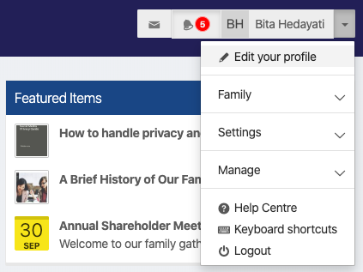
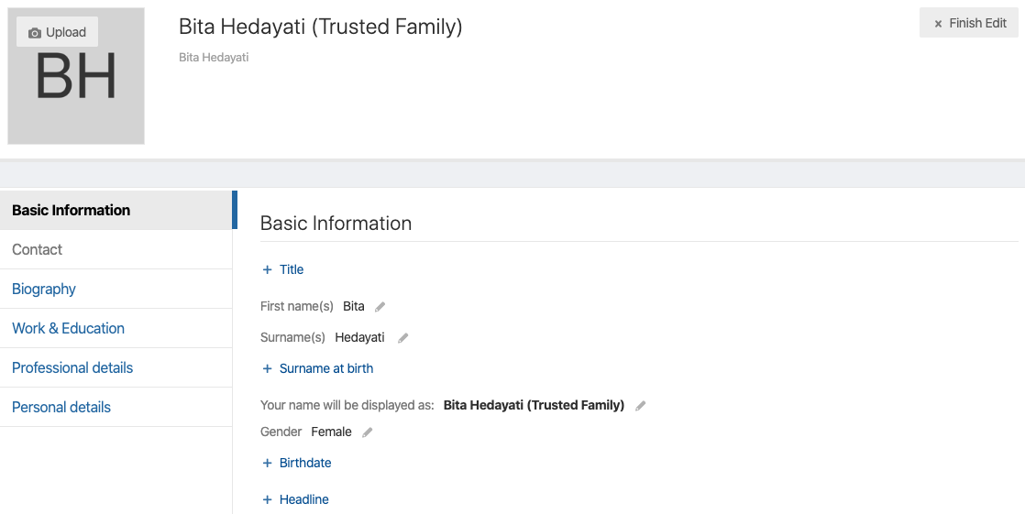
What to do Next?
Find Your Profile
Complete Your Profile
Go to your profile by hitting the arrow button beside your name. Select Edit your profile.
Hit the Upload button on your initials to upload a profile picture. Complete the rest of your profile by entering your personal details in the desired fields.
https://insertyourdomain.trustedfamily.net

Slide 10
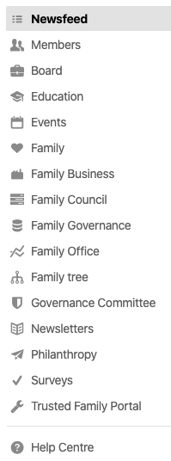
Explore the Platform
Navigate the Menu on the Left
You will see the different menu items available to find information about the family, the company and other resources. Notice you might not see all the menu items. Certain categories are restricted for specific groups, i.e Family Governance. Only the members of specific groups will have visibility to that menu item and its contents.
https://insertyourdomain.trustedfamily.net

Slide 11
Explore the Platform
The Newsfeed
Scroll down the newsfeed and view the latest information shared with you. Easily engage with family members through the like and comment features.
https://insertyourdomain.trustedfamily.net

Slide 12
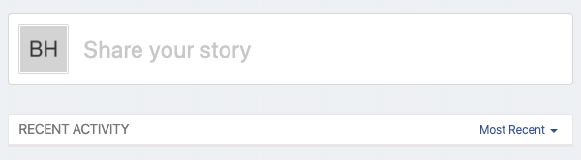
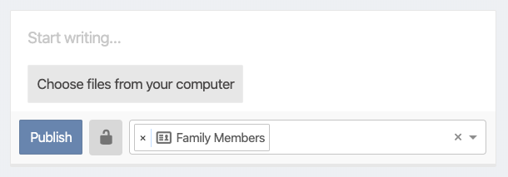
How to Share New Content
From the Newsfeed
On the top of the newsfeed, click on Share your story to activate the creation bar.
Write something about what you’re sharing. (optional)
Select your file or drag & drop here.
Choose who you want to share with.
https://insertyourdomain.trustedfamily.net

Slide 13
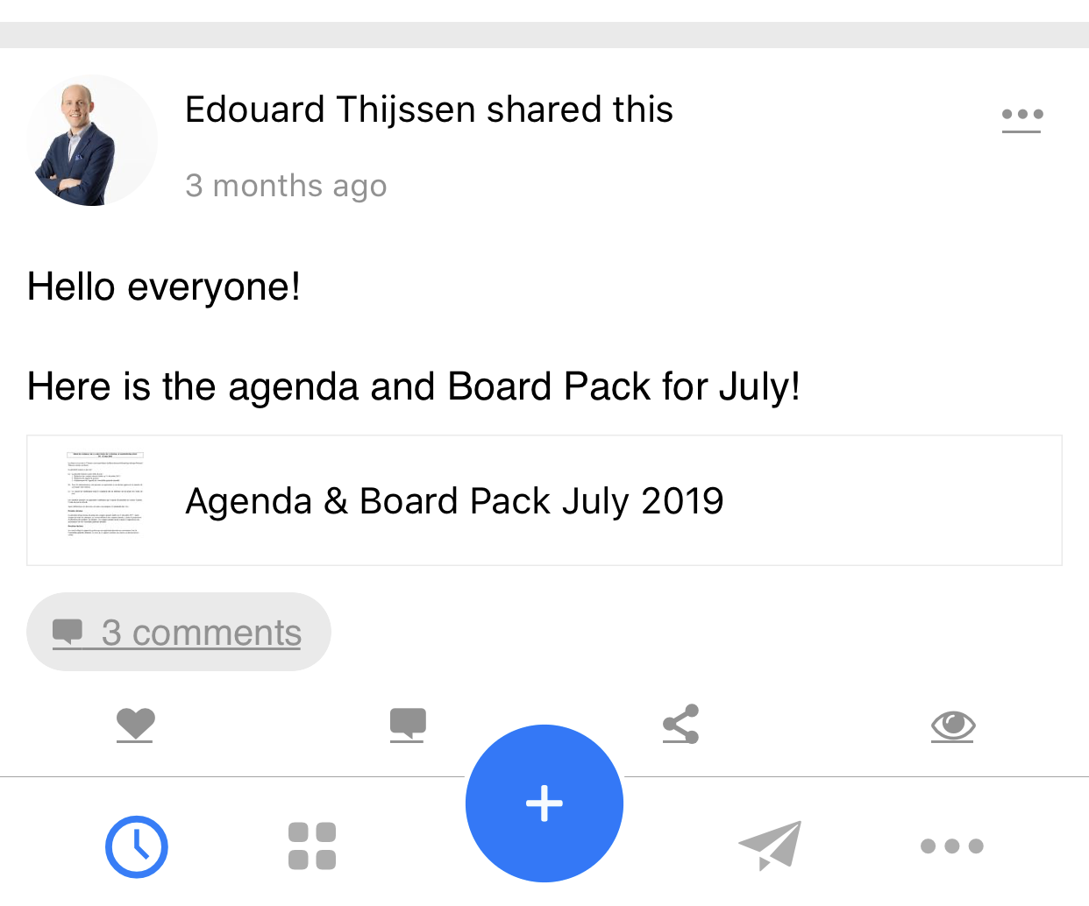
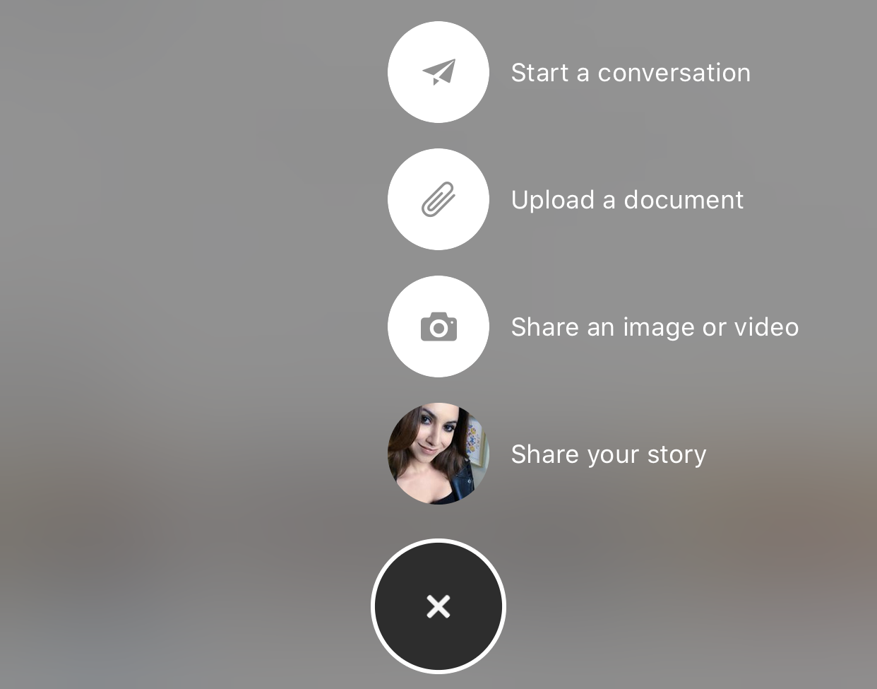
How to Share New Content
From Your Phone
Hit the creation button (+) to share new content and more.
https://insertyourdomain.trustedfamily.net

Slide 14
Let’s Visit the Platform
https://insertyourdomain.trustedfamily.net

